Slide 1
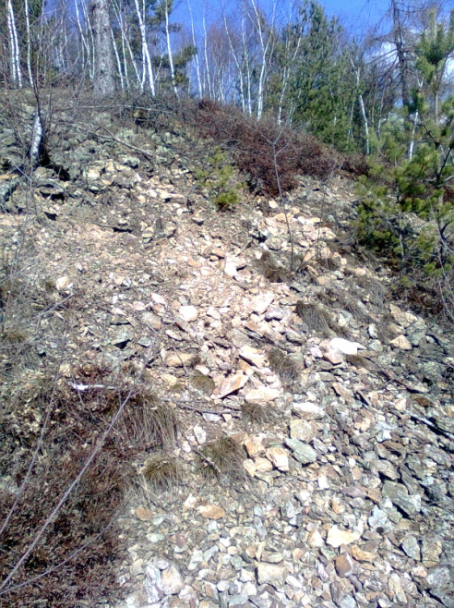
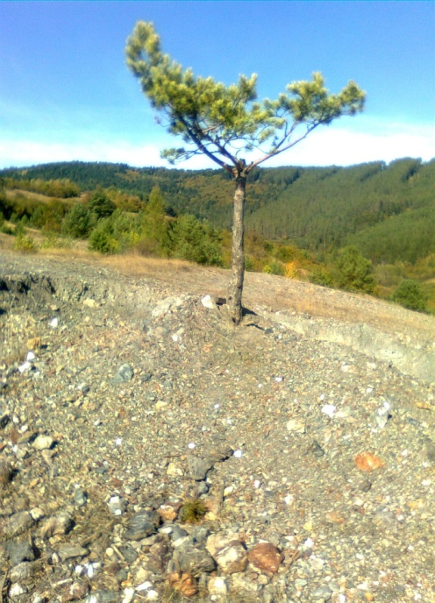
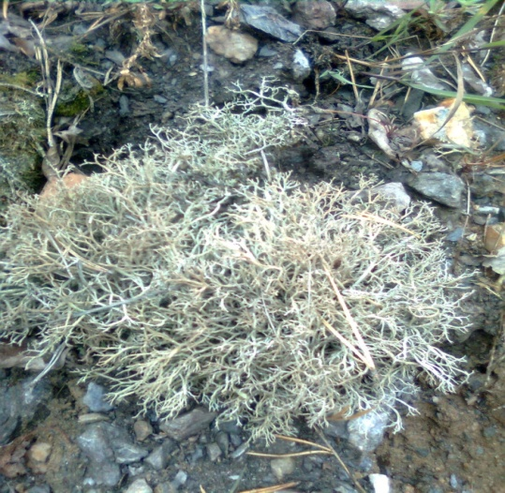
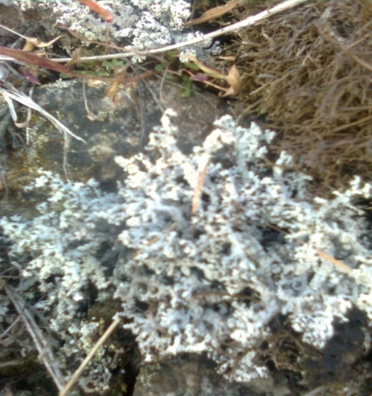
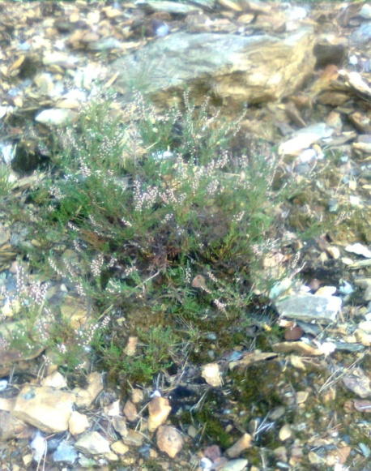
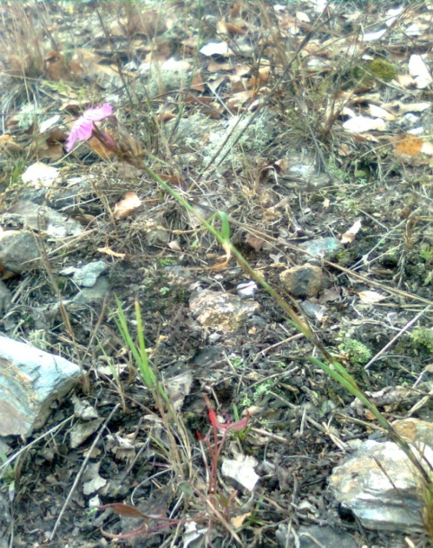
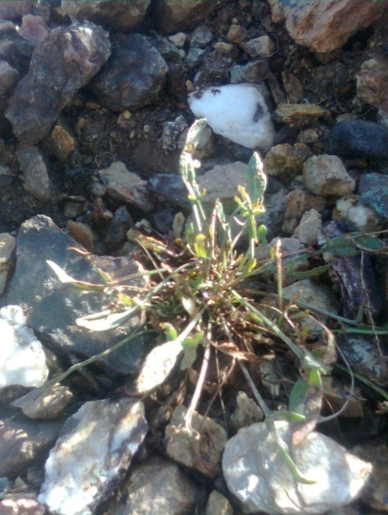
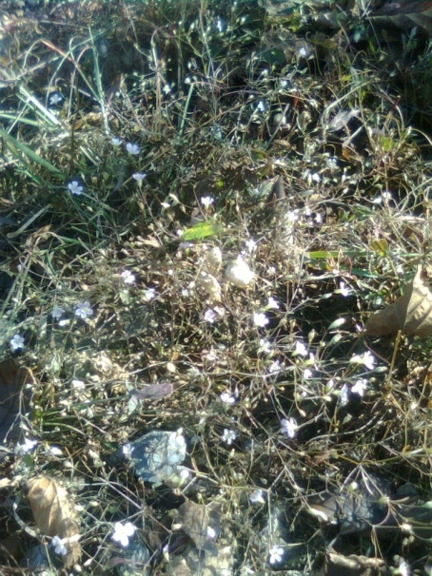
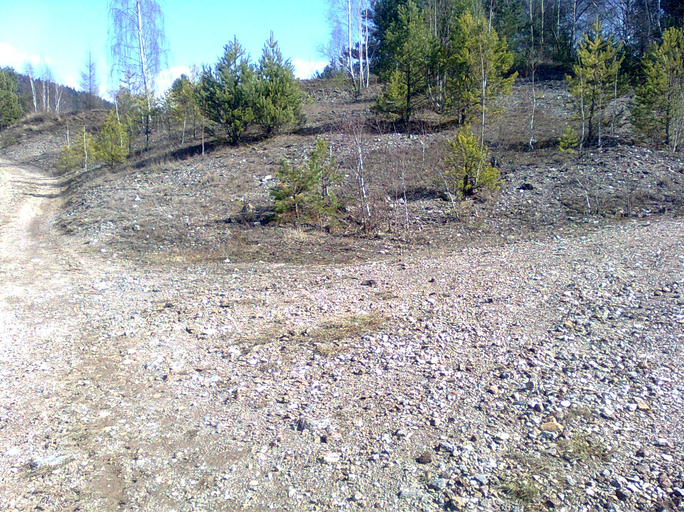
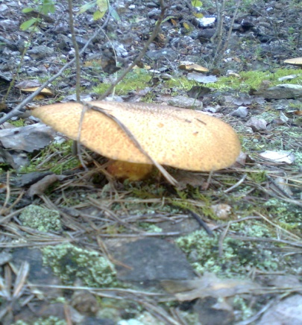
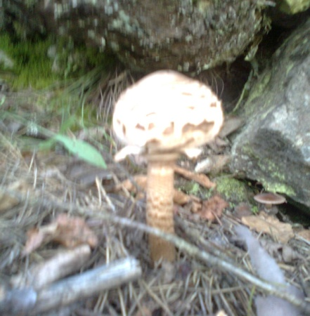
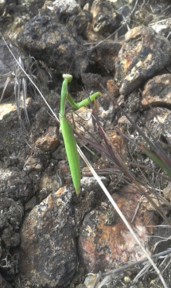
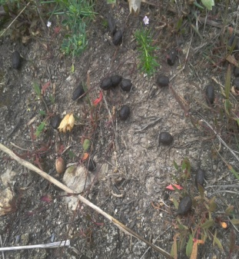
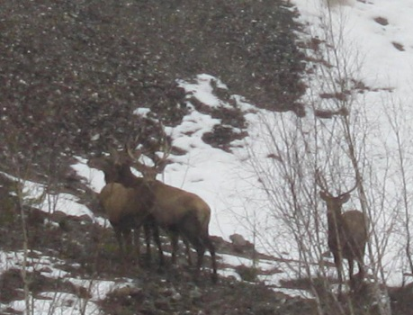
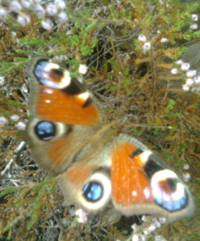
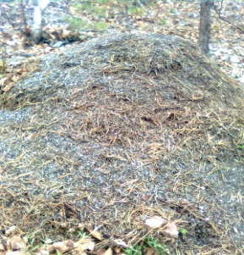
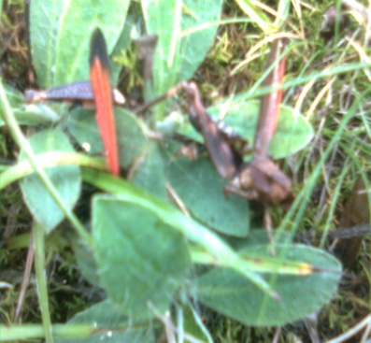
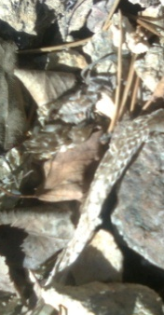
Results
1.1 Geological and ecological characteristic of the spoil heap
Mining heap in Gelnica in a location Slovenské Cechy-Gaple, is according to the data provided by Mining Museum of Gelnica, almost 200 years old secondary complex with a total area of around 5 500 square meters. It is created mostly by crystalline slate, quartz, siderit, chalcopyrite, pyrite, tetrahedrite and also partially by limonit and secondary copper minerals malachite, azurite, olivenite, antlerite and cornwallite. A part of the heap is located outside of Slovenské Cechy.
From the ecological point of view, the heap represents a specific type of habitat characterized by a lack of water and soil, a high content of toxic metals, very limited variety and also population of vegetation species – islet habitation. We may there very often find solitary and stunted organisms, occasionally they might suffer from visible impaired vitality (Pic. 3 , 4).
1.2 pH properties of soil
The soil from the heap in Gelnica is characterized by an acidic pH of 5,1. We verified the value multiple times to get the most precise results.
1.3 Habitation of the spoil heap by vegetation
Pic. 3 Inhospitable
conditions on the heap
Pic. 4 Soliter of Pinus sylvestris
The area of of the heap is strictly separated from the surrounding environment, habitation of the heap is located in the peripheral areas and hollows. Total coverage of the heap reaches up to 40%. The most frequent species were Betula pendula a Pinus sylvestris. The plants were often stunted and their impaired vitality was actually very easy to spot for example thanks to the orange and red spots on the needles of Pinus sylvestris. The other plants occurying there were Agrostis capillaris, Vaccinium myrtillus and Calluna vulgaris. The most frequent representatives of the mosses Ceratodon purpureus and Racomitrium lanuginosum. The central part is characterized by places with irregular habitation, the most common plant is Agrostis capillaris. Besides the others, we would like to point out species like Dianthus cartusianorum, Acetosella vulgaris, Gypsophila muralis and Silene vulgaris.
Pic. 5 Cladonia arbuscula
subsp. mitis
Pic. 6 Stereocaulon tomentosum
Pic. 7 Calluna vulgaris
Pic. 8 Dianthus carthusianorum
Pic. 9 Acetosella vulgaris
Pic. 10 Gypsophila muralis
A very sovereign representation in the centre had both Cladonia arbuscula subsp. mitis and Stereocaulon dactylophyllum. We have to point out a fact that although the species of Stereocaulon (S.tomentosum can be found in great numbers on the heap) are in the Red List of endangered species they achieve great numbers on the mining heap in Gelnica..
Pic. 11 Place with the most frequent occurance
of genus Stereocaulon
1.4 Phytocenological records
Record no. 1
Locality: Gelnica, lokalita Slovenské Cechy-Gaple, spoil heap, peripheral part
Exposure: SW, Slope: 30º , Altitude: 520 m.n.m. Area: 25 m²
Coverage: E2 30%, E1 40%, E0 40%
E2 Pinus sylvestris juv. 2a, Betula pendula juv. 2a, Coryllus avellana +,
E1 Calluna vulgaris 2m, Vaccinium myrtillus 1, Betula pendula juv. 1, Agrostis capillaris +
E0 Cladonia arbuscula subsp. mitis 2a, Stereocaulon dactylophyllum 2m, Cladonia pyxidata 1, Racomitrium lanuginosum +, Ceratodon purpureus +
Record no. 2
Locality: Gelnica, Slovenské Cechy-Gaple, spoil heap, central part
Exposure: SW, Slope: 40º, Altitude: 530 m.n.m., Area: 25 m²
Coverage: E1 30%, E0 50%
E1 Agrostis capillaris 2, Vaccinium myrtillus 2m, Calluna vulgaris 1, Betula pendula juv. 1, Pinus sylvestris juv. 1, Dianthus carthusianorum +, Gypsophyla muralis r, Silene dioica r
E0 Cladonia arbuscula subsp. mitis 2b, Cladonia pyxidata 1, Stereocaulon dactylophyllum 1, Cladonia rangiformis +
1.5 Fungi on the heap
Tab. 1 The list of fungi on spoil heap in Gelnica in locality Slovenské Cechy - Gaple
Despite the fact that the heap is characterized by a very poor variety of species and also by its relatively low coverage, in months August and September we may find here also different species of fungi, next to the mosses and lichens. The most common fungi is Suillus luteus that may be found not only in the peripheral parts of the heap, but in its centre as well reaching seriously great numbers there. Altogether, we were able to record 8 different fungi species, as they are presented in the table.
Species | Peripheral part | Central part
Suillus luteus | + | +
Leccinum scabrum | + | +
Lactarium torminosus | + | -
Leccinum thalassinum | - | +
Boletus edulis | + | -
Amanita muscaria | + | -
Macrolepiota procera | + | -
Russula nigricans | + | -
1.6 Fauna on the spoil heap
Pic. 12 Suillus luteus
Similarly to the group of plants and lichens which slowly sorted out as a possible habitants of the heap, there are also certain xerophilic and thermophilic animal species, primarily invertebrates. The strict separation of the heap from surrounding meadow areas is not a barrier for a continuous migration of various animal species. We observed movement of different mammals, such as Capreolus capreolus or Lepus europaeus through the area of the heap. It acts as kind of so-called biocorridor for them, where fauna from both ecosystem meets, thus creating a very unique environment.
Pic. 13 Macrolepiota procera
Pic. 18 Mantis
religiosa
Pic. 19 Substistence
track of Lepus
europaeus
Pic.. 20 Cervus elaphus
We may permanently observe occurence of e.g. grasshoppers, butterflies or other species, which are, hovewer, tied to the meadow ecosystem. To mention some of the invertebrates which permanently habitate the heap, we may talk about ants, Vespa crabro and protected Mantis religiosa. We alsou found Vipera berus and Lacerta agilis, as the representatives of reptiles.
Pic. 14 Inachis io
Pic. 15 Anthill of
Forica rufa
Pic 16. Psofus stridulus
Pic. 17 Stripped skin of Vipera berus

